Slide 1
free swimming

Slide 3

CF sound

Slide 4
gap

Slide 5
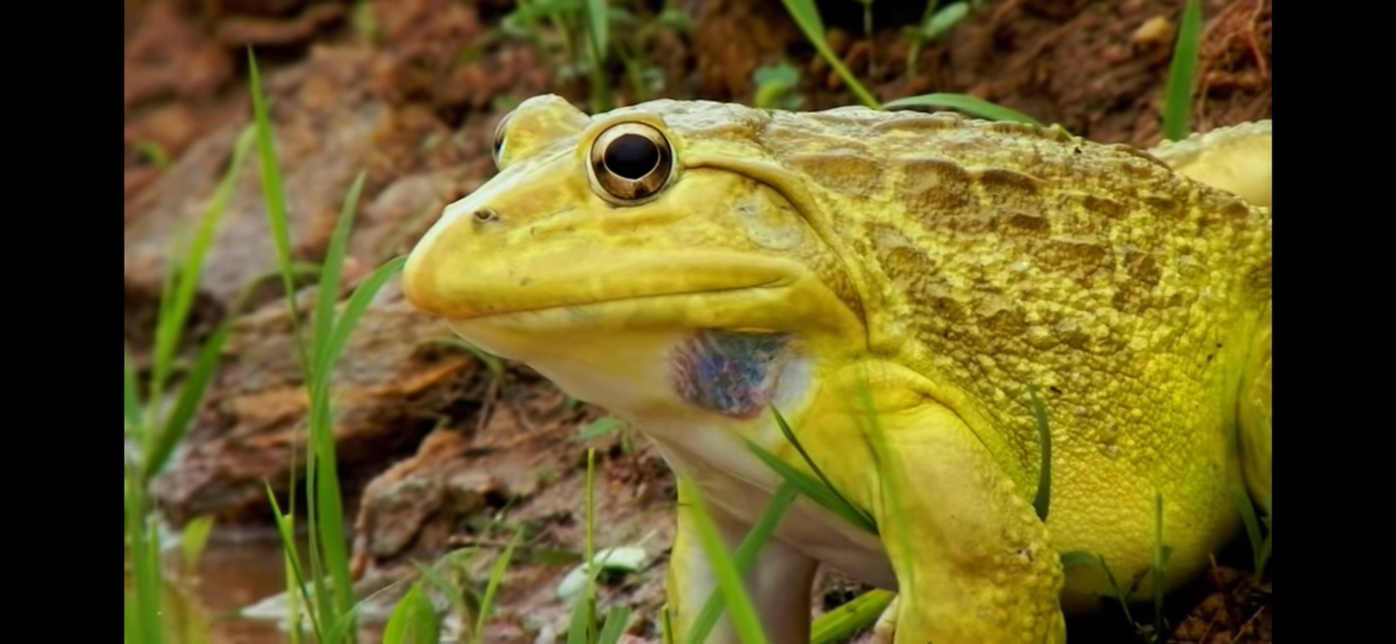

Slide 6
break

